Slide 1
Space Vision 2018
A journey

Slide 2

Build Space Better
Through collaboration we can achieve greater heights, improve on past accomplishments, and shape the future of space exploration.

Slide 3
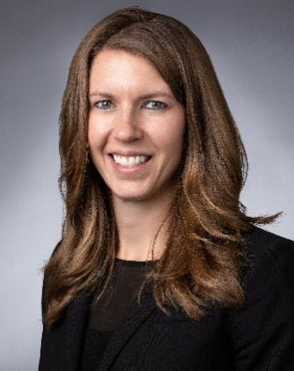
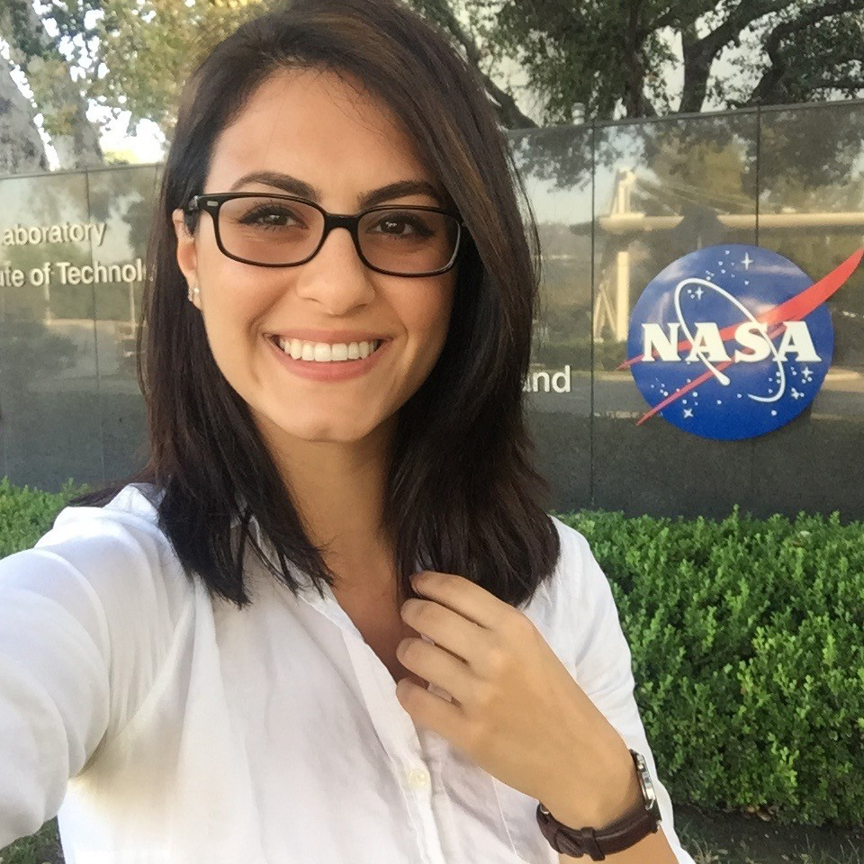
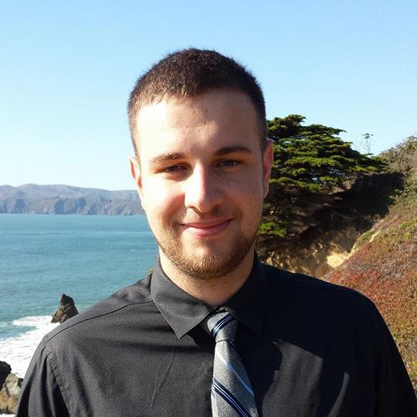
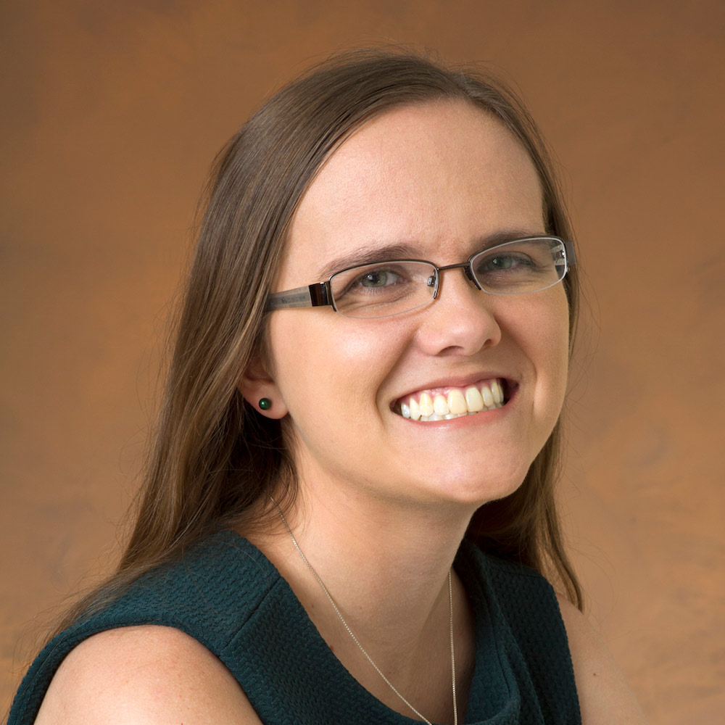
Who is it?
Danielle Richey
Advanced Programs - Lockheed Martin Space
Diana Alsindy
Propulsion Engineer - Virgin Orbit
Kyle Adriany
Chief Technology Officer - Additive Rocket Corporation (ARC)
Keri Bean
Mission Operations Engineer - NASA Jet Propulsion Laboratory
https://www.spacevision.sedsucsd.org/program/

Slide 4
What is it?
Space Vision 2018

Slide 5
When is it?
The conference runs November 1st – 3rd
We would be leaving from Boston the morning of the 1st, and Thursday and flying back on Sunday

Slide 6

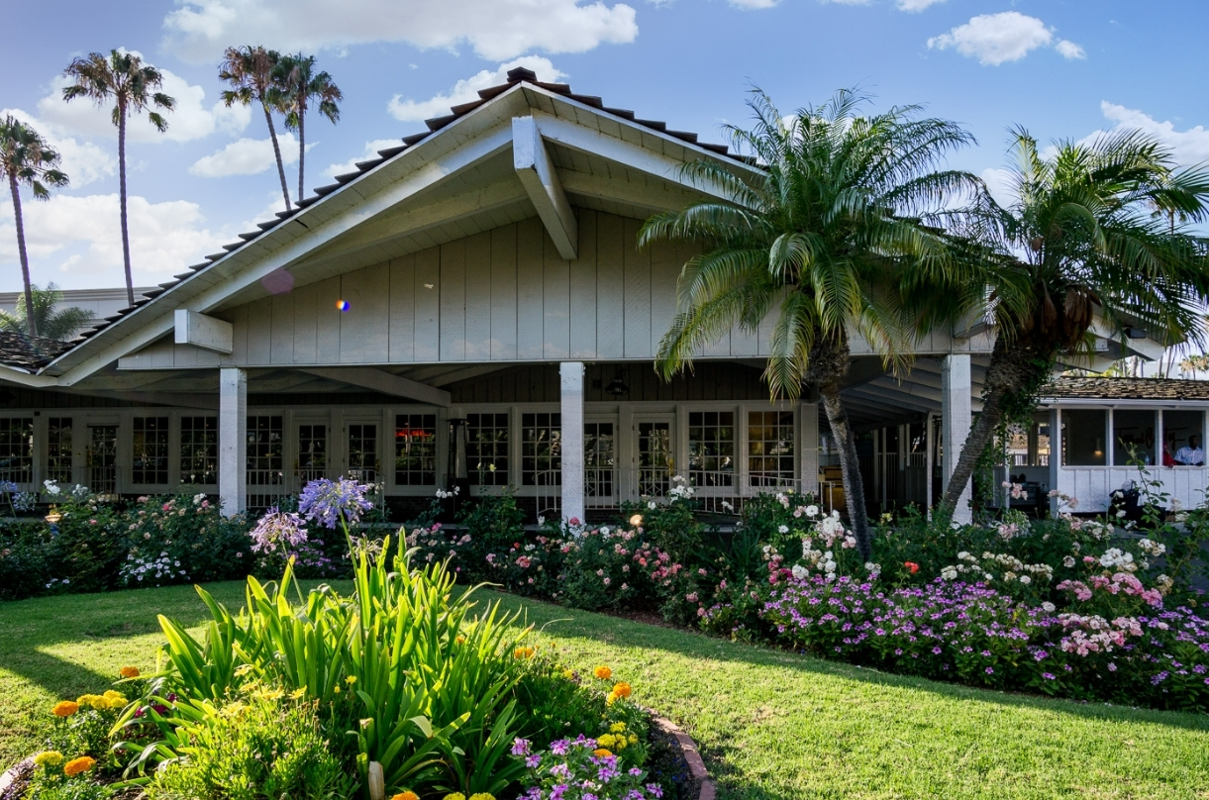
Where is it?
San Diego!!!!
Hosted by The University of San Diego SEDS
Town and Country Hotel in San Diego

Slide 7
Why is it?
Mini vacation in the middle of your semester
Networking with professionals and other students

Slide 8
Budget
$85 Entrance to the Conference
Round Trip Flight coming in between $337
Room for 3 nights is $150 per person
-$67 From SafC
Will attempt to reimbuse $2-300 per person from SEDS fund over the year
If 12 go, then we save another $50 per person for Charlie’s room
TOTAL
$455 up front
-$2-300 reimbursement
$155-255 per person

